Slide 1
Docker

Slide 2
What is Container?

Slide 3
What is Container?
A container is a lightweight, standalone, and executable software package that includes everything needed to run a piece of software, including the code, runtime, system tools, system libraries, and settings

Slide 4
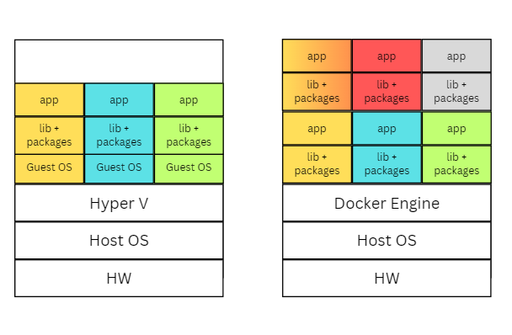
VM
Container
Resource Utilization
Speed
Scalability
Isolation
Portability

Slide 5
What is Docker?
Docker is an open-source platform used to develop, ship, and run applications inside containers.
Docker allows applications to be packaged along with their dependencies into isolated units called containers

Slide 6
Traditional Deployment Challenges
Problem:
- “It works on my machine” syndrome due to inconsistent environments.
- Heavyweight VMs with significant overhead.
Examples:
- Dependency conflicts, OS mismatches.
- Slow deployment and scaling.

Slide 7
How Docker Solves These Challenges
Consistency: Runs the same on any machine.
Isolation: Each container has its own file system, network, and process space.
Efficiency: Shares the host OS kernel — lightweight and fast.

Slide 8
Docker vs. Virtual Machines
Feature | Docker Containers | Virtual Machines
OS Overhead | Shares host OS | Full guest OS per VM
Startup Time | Seconds | Minutes
Resource Usage | Minimal (MBs) | High (GBs)
Deployment | Faster, consistent | Slower, heavier
Portability | Very high | Limited by hypervisor

Slide 9
Key Benefits of Docker
Portability: Develop locally, deploy anywhere.
Rapid Deployment: Start containers in seconds.
Version Control: Tag, rollback, and manage container versions easily.
Scalability: Orchestrate thousands of containers with Kubernetes.
Resource Efficiency: Lower CPU and RAM usage than VMs.

Slide 10
Docker Image, Dockerfile, Docker Container, Docker Hub
Docker images is a read-only template used to create Docker containers.
Docker images are built from a set of instructions defined in a text file called a Dockerfile. The Dockerfile contains the configuration and dependencies required for the application.
Images are stored in a repository, and one of the most popular repositories for Docker images is Docker Hub.
A Docker container is a runnable instance of a Docker image.

Slide 11
Docker Ecosystem
Docker Engine: Core container runtime.
Docker Compose: Multi-container app management.
Docker Hub: Public/private container registry.
Docker Swarm & Kubernetes: Container orchestration.

Slide 12
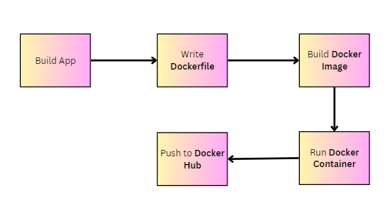
Docker Workflow

Slide 13
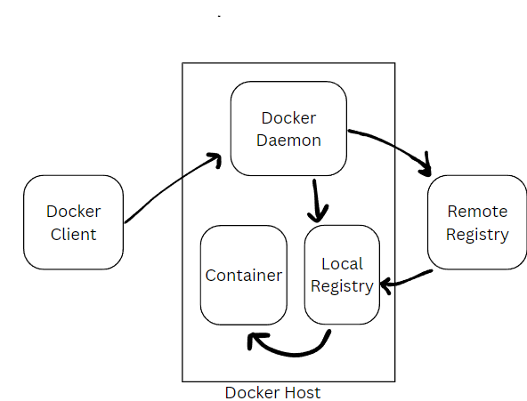
How Docker works?
docker run hello-world

Slide 14
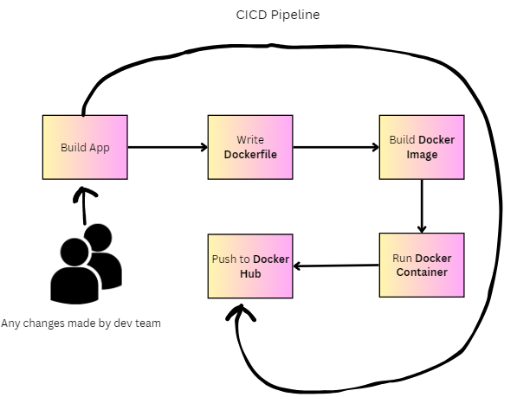

Slide 15
Use Cases
Development: Isolated dev environments per project.
Testing: Spin up test environments instantly.
CI/CD: Automate builds, tests, and deployments.
Microservices: Break apps into small, manageable services.
Cloud: Deploy containers on AWS, Azure, GCP, etc.

Slide 16
Real-World Examples
Spotify: Microservices architecture in containers.
Airbnb: CI/CD with Docker.
Paypal: Fast, consistent deployment pipeline.
Groupon: Containerized microservices at scale.

